Slide 1
主要内容
Introduction to Dynamic Programming
Weighted Interval Scheduling
Longest Common Subsequence
Chain Matrix Multiplication
Infinite Knapsack Problem
0-1 Knapsack Problem
Maximal Independent Set
Optimal Substructure
Dynamic programming algorithm
Floyd-Warshall Algorithm

Slide 2
Chain Matrix Multiplication

Slide 3
Chain Matrix Multiplication
考虑进行的乘法的次数

Slide 4
Chain Matrix Multiplication
Consider the case of 3 matrices: A₁ be 5 × 4, A₂ be 4 × 6 and A₃ be 6 × 2
Chain Matrix Multiplication Problem: Given a sequence of matrices A₁, . . . , A_{n} and dimensions p₀, . . . , p_{n} where A_{i} is of dimension p_{i−1} × p_{i}, determine the order of multiplication (represented, say, as a binary tree) that minimizes the number of operations.

Slide 5
Dynamic programming approach
Let A_{i..j} denote the result of multiplying matrices i through j. A_{i..j} is a p_{i−1} × p_{j} matrix.
At the highest level, it is to select a point to decompose the sequence multiplication.
This reduces to two problems:
What is the best place to split the chain? (what is k?)
How do we further split each of the subsequences A_{1..k} and A_{k+1..n}?

Slide 6
Recursive formulation
For 1 ≤ i ≤ j ≤ n, let m(i,j) denote the minimum number of multiplications needed to compute A_{i..j}.

Slide 7
Recursive formulation
we store the values of m(i, j ) in a 2-dimensional array m[1..n, 1..n].
In the process of computing m(i, j) we need to access values m(i, k) and m(k + 1, j) for k lying between i and j.
We cannot compute m[][] row-by-row, because calculating m[3][5] will need m[4][5] which has not been calculated yet.
We first solve the problem for chains of length 1 (which is trivial), then chains of length 2, and so on, until we come to m[1, n], which is the total chain of length n.

Slide 8
Recursive formulation
Let L = j − i + 1 denote the length of the subchain being multiplied.
For L=1, m[i][i]=0;
If a subchain of length L starts at position i, then j=i+L−1.

Slide 9
DP based chain matrix multiplication
Matrix-Chain(p[0..n]) {
m = array[1..n, 1..n]
s = array[1..n-1, 2..n]
for (i = 1 to n) m[i, i] = 0
for (L = 2 to n) {
for (i = 1 to n - L + 1) {
j=i+L-1
m[i,j] = INFINITY
for (k = i to j - 1) {
cost = m[i, k] + m[k+1, j] + p[i-1]*p[k]*p[j]
if (cost < m[i, j]) {
m[i, j] = cost
s[i, j] = k
}
}
}
}
return m[1, n] (final cost) and s (splitting markers)
}
// initialize
// L = length of subchain
// check all splits
Complexity O(n³)

Slide 10
基于动态规划的链式矩阵乘法
s[i,j]
Matrix-Chain(p[0..n]) {
m = array[1..n, 1..n]
s = array[1..n-1, 2..n]
for (i = 1 to n) m[i, i] = 0
for (L = 2 to n) {
for (i = 1 to n - L + 1) {
j=i+L-1
m[i,j] = INFINITY
for (k = i to j - 1) {
cost = m[i, k] + m[k+1, j] + p[i-1]*p[k]*p[j]
if (cost < m[i, j]) {
m[i, j] = cost
s[i, j] = k
}
}
}
}
}
4
1
j
3
i
3
2
1
3
2
3
1
2
3
m[i,j]
4
1
j
158
i
3
2
4*6*2+5*4*2
88
104
2
3
120
48
84
1
4
0
0
0
0
5
A₁
4
A₂
6
A₃
2
A₄
7
p₀
p₁
p₂
p₃
p₄

Slide 11
DP based chain matrix multiplication

Slide 12
根据记录的k计算矩阵乘法
do-mult(i, j) {
if (i == j)
return A[i]
else {
k = s[i,j]
X = do-mult(i, k)
Y = do-mult(k+1, j)
return X * Y
}
}
k=s[1,4]=3
X=do-multi(1,3)
Y=do-multi(4,4)
X*A₄
k=s[1,3]=1
X=do-multi(1,1)
Y=do-multi(2,3)
A₁*Y*A₄
k=s[2,3]=2
X=do-multi(2,2)
Y=do-multi(3,3)
A₁A₂ A₃ A₄

Slide 13
练习
直观上总结一下矩阵链式乘法
5 4 6 2 7
5 4 2 7
5 2 7
5 7
贪心算法和动态规划究竟是否有差异呢？
50 10 40 30 5
贪心算法的话，总乘法次数是多少？
动态规划的话，总乘法次数是多少？
有相邻的三个数中间大两边小的优先计算
看似可以设计一种贪心机制
可以设计一种贪心算法来进行矩阵链式乘法

Slide 14
主要内容
Introduction to Dynamic Programming
Weighted Interval Scheduling
Longest Common Subsequence
Chain Matrix Multiplication
Infinite Knapsack Problem
0-1 Knapsack Problem
Maximal Independent Set
Optimal Substructure
Dynamic programming algorithm
Floyd-Warshall Algorithm

Slide 15
Example 4: Knapsack Problem
We have n items with weights and values:
And we have a knapsack:
it can only carry so much weight:
Item:
Weight:
6
2
4
3
11
Value:
20
8
14
13
35
Capacity: 10

Slide 16
Item:
Weight:
6
2
4
3
11
Capacity: 10
Value:
20
8
14
13
35
Unbounded Knapsack:
Suppose I have infinite copies of all items.
What’s the most valuable way to fill the knapsack?
0/1 Knapsack:
Suppose I have only one copy of each item.
What’s the most valuable way to fill the knapsack?
Total weight: 10
Total value: 42
Total weight: 9
Total value: 35

Slide 17
Some notation
Item:
…
w₁
w₂
w₃
w_{n}
Weight:
v₁
v₂
v₃
v_{n}
Value:
Capacity: W

Slide 18
Recipe for applying Dynamic Programming
Step 1: Identify optimal substructure.
Step 2: Find a recursive formulation for the value of the optimal solution.
Step 3: Use dynamic programming to find the value of the optimal solution.
Step 4: If needed, keep track of some additional info so that the algorithm from Step 3 can find the actual solution.
Step 5: If needed, code this up like a reasonable person.

Slide 19
Optimal substructure
Sub-problems:
Unbounded Knapsack with a smaller knapsack.
K[x] = value you can fit in a knapsack of capacity x
First solve the problem for small knapsacks
Then larger knapsacks
Then larger knapsacks

Slide 20
Optimal substructure
item i
Suppose this is an optimal solution for capacity x:
Then this is optimal for capacity x - w_{i}:
Say that the optimal solution contains at least one copy of item i.
Weight w_{i}
Value v_{i}
Capacity x
Value V
Why?
1 minute think
(wait) 1 minute share
Capacity x – w_{i}
Value V - v_{i}

Slide 21
Optimal substructure
item i
Suppose this is an optimal solution for capacity x:
Then this is optimal for capacity x - w_{i}:
Say that the optimal solution contains at least one copy of item i.
Weight w_{i}
Value v_{i}
Capacity x
Value V
If I could do better than the second solution, then adding a turtle to that improvement would improve the first solution.
Capacity x – w_{i}
Value V - v_{i}

Slide 22
Recipe for applying Dynamic Programming
Step 1: Identify optimal substructure.
Step 2: Find a recursive formulation for the value of the optimal solution.
Step 3: Use dynamic programming to find the value of the optimal solution.
Step 4: If needed, keep track of some additional info so that the algorithm from Step 3 can find the actual solution.
Step 5: If needed, code this up like a reasonable person.

Slide 23
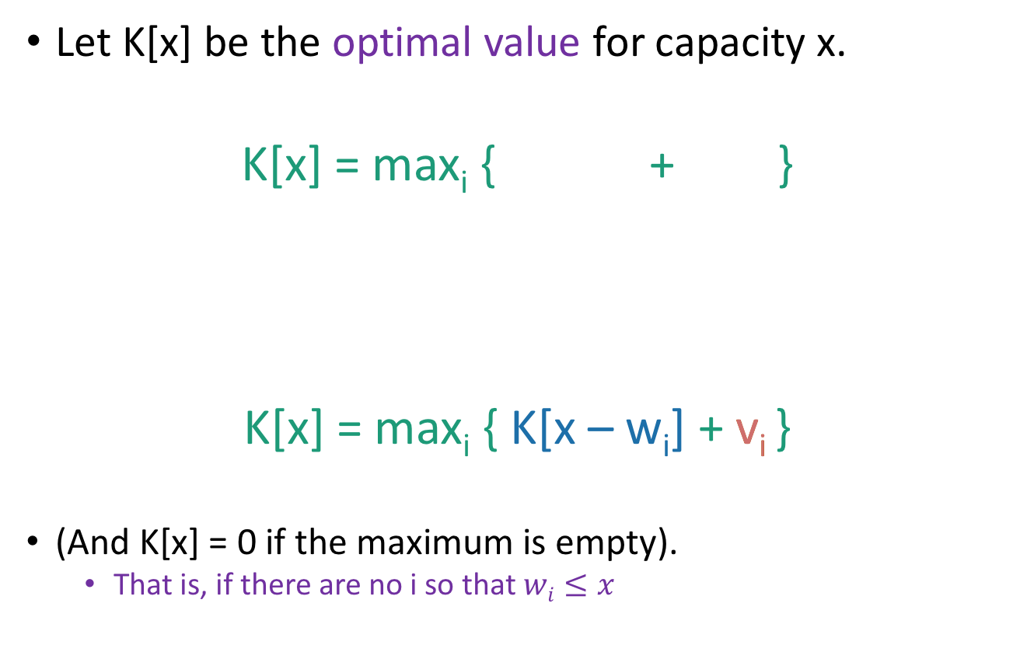
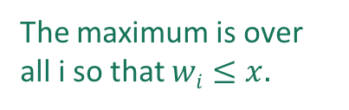
Recursive relationship
Let K[x] be the optimal value for capacity x.
K[x] = max_{i} { + }
K[x] = max_{i} { K[x – w_{i}] + v_{i} }
(And K[x] = 0 if the maximum is empty).
That is, if there are no i so that $wi≤x$
The maximum is over all i so that $wi≤x.$
Optimal way to fill the smaller knapsack
The value of item i.

Slide 24
Recipe for applying Dynamic Programming
Step 1: Identify optimal substructure.
Step 2: Find a recursive formulation for the value of the optimal solution.
Step 3: Use dynamic programming to find the value of the optimal solution.
Step 4: If needed, keep track of some additional info so that the algorithm from Step 3 can find the actual solution.
Step 5: If needed, code this up like a reasonable person.

Slide 25
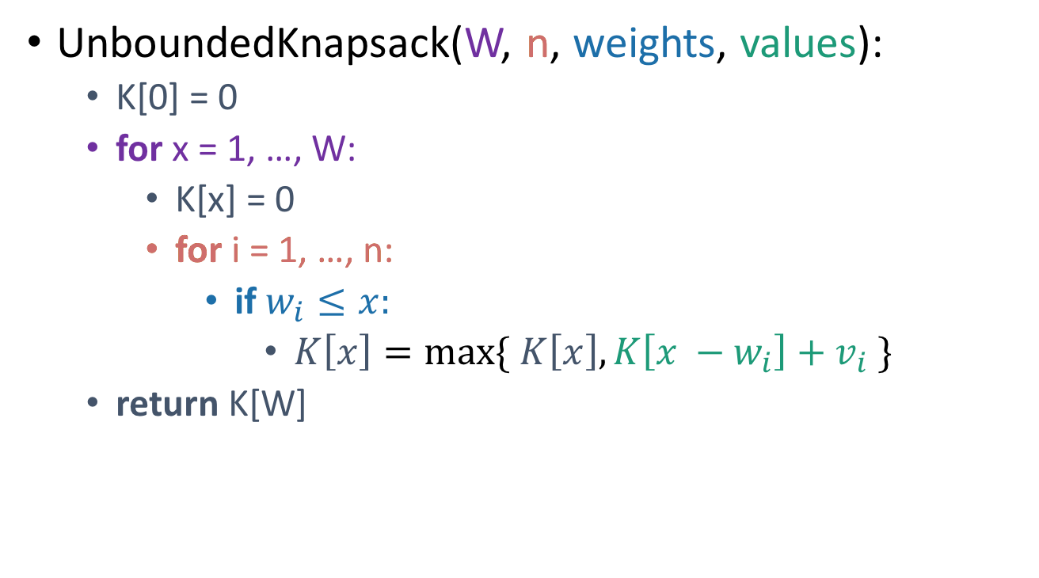
Let’s write a bottom-up DP algorithm
UnboundedKnapsack(W, n, weights, values):
K[0] = 0
for x = 1, …, W:
K[x] = 0
for i = 1, …, n:
if $w_{i}≤x:$
$K\left[x\right]=\max{\{ K\left[x\right], K\left[x −w_{i}\right]+v_{i} \}}$
return K[W]
Running time: O(nW)
K[x] = max_{i} { + }
= max_{i} { K[x – w_{i}] + v_{i} }

Slide 26
Recipe for applying Dynamic Programming
Step 1: Identify optimal substructure.
Step 2: Find a recursive formulation for the value of the optimal solution.
Step 3: Use dynamic programming to find the value of the optimal solution.
Step 4: If needed, keep track of some additional info so that the algorithm from Step 3 can find the actual solution.
Step 5: If needed, code this up like a reasonable person.

Slide 27
Let’s write a bottom-up DP algorithm
UnboundedKnapsack(W, n, weights, values):
K[0] = 0
for x = 1, …, W:
K[x] = 0
for i = 1, …, n:
if $w_{i}≤x:$
$K\left[x\right]=\max{\{ K\left[x\right], K\left[x −w_{i}\right]+v_{i} \}}$
return K[W]
K[x] = max_{i} { + }
= max_{i} { K[x – w_{i}] + v_{i} }

Slide 28
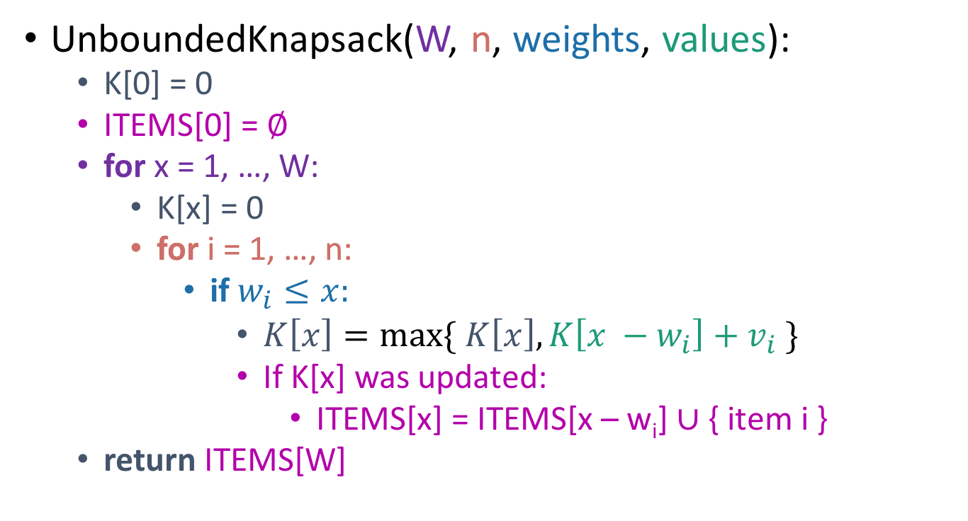
Let’s write a bottom-up DP algorithm
UnboundedKnapsack(W, n, weights, values):
K[0] = 0
ITEMS[0] = $∅$
for x = 1, …, W:
K[x] = 0
for i = 1, …, n:
if $w_{i}≤x:$
$K\left[x\right]=\max{\{ K\left[x\right], K\left[x −w_{i}\right]+v_{i} \}}$
If K[x] was updated:
ITEMS[x] = ITEMS[x – w_{i}] $∪$ { item i }
return ITEMS[W]
K[x] = max_{i} { + }
= max_{i} { K[x – w_{i}] + v_{i} }

Slide 29

Example
UnboundedKnapsack(W, n, weights, values):
K[0] = 0
ITEMS[0] = $∅$
for x = 1, …, W:
K[x] = 0
for i = 1, …, n:
if $w_{i}≤x:$
$K\left[x\right]=\max{\{ K\left[x\right], K\left[x −w_{i}\right]+v_{i} \}}$
If K[x] was updated:
ITEMS[x] = ITEMS[x – w_{i}] $∪$ { item i }
return ITEMS[W]
0
1
2
3
4
0
K
ITEMS
Item:
Weight:
1
2
3
Value:
1
4
6
Capacity: 4

Slide 30
Example
UnboundedKnapsack(W, n, weights, values):
K[0] = 0
ITEMS[0] = $∅$
for x = 1, …, W:
K[x] = 0
for i = 1, …, n:
if $w_{i}≤x:$
$K\left[x\right]=\max{\{ K\left[x\right], K\left[x −w_{i}\right]+v_{i} \}}$
If K[x] was updated:
ITEMS[x] = ITEMS[x – w_{i}] $∪$ { item i }
return ITEMS[W]
0
1
2
3
4
0
1
K
ITEMS
Item:
Weight:
1
2
3
Value:
1
4
6
ITEMS[1] = ITEMS[0] +
Capacity: 4

Slide 31
Example
UnboundedKnapsack(W, n, weights, values):
K[0] = 0
ITEMS[0] = $∅$
for x = 1, …, W:
K[x] = 0
for i = 1, …, n:
if $w_{i}≤x:$
$K\left[x\right]=\max{\{ K\left[x\right], K\left[x −w_{i}\right]+v_{i} \}}$
If K[x] was updated:
ITEMS[x] = ITEMS[x – w_{i}] $∪$ { item i }
return ITEMS[W]
0
1
2
3
4
0
1
2
K
ITEMS
Item:
Weight:
1
2
3
Value:
1
4
6
ITEMS[2] = ITEMS[1] +
Capacity: 4

Slide 32
Example
UnboundedKnapsack(W, n, weights, values):
K[0] = 0
ITEMS[0] = $∅$
for x = 1, …, W:
K[x] = 0
for i = 1, …, n:
if $w_{i}≤x:$
$K\left[x\right]=\max{\{ K\left[x\right], K\left[x −w_{i}\right]+v_{i} \}}$
If K[x] was updated:
ITEMS[x] = ITEMS[x – w_{i}] $∪$ { item i }
return ITEMS[W]
0
1
2
3
4
0
1
4
K
ITEMS
Item:
Weight:
1
2
3
Value:
1
4
6
ITEMS[2] = ITEMS[0] +
Capacity: 4

Slide 33
Example
UnboundedKnapsack(W, n, weights, values):
K[0] = 0
ITEMS[0] = $∅$
for x = 1, …, W:
K[x] = 0
for i = 1, …, n:
if $w_{i}≤x:$
$K\left[x\right]=\max{\{ K\left[x\right], K\left[x −w_{i}\right]+v_{i} \}}$
If K[x] was updated:
ITEMS[x] = ITEMS[x – w_{i}] $∪$ { item i }
return ITEMS[W]
0
1
2
3
4
0
1
4
5
K
ITEMS
Item:
Weight:
1
2
3
Value:
1
4
6
ITEMS[3] = ITEMS[2] +
Capacity: 4

Slide 34
Example
UnboundedKnapsack(W, n, weights, values):
K[0] = 0
ITEMS[0] = $∅$
for x = 1, …, W:
K[x] = 0
for i = 1, …, n:
if $w_{i}≤x:$
$K\left[x\right]=\max{\{ K\left[x\right], K\left[x −w_{i}\right]+v_{i} \}}$
If K[x] was updated:
ITEMS[x] = ITEMS[x – w_{i}] $∪$ { item i }
return ITEMS[W]
0
1
2
3
4
0
1
4
6
K
ITEMS
Item:
Weight:
1
2
3
Value:
1
4
6
ITEMS[3] = ITEMS[0] +
Capacity: 4

Slide 35
Example
UnboundedKnapsack(W, n, weights, values):
K[0] = 0
ITEMS[0] = $∅$
for x = 1, …, W:
K[x] = 0
for i = 1, …, n:
if $w_{i}≤x:$
$K\left[x\right]=\max{\{ K\left[x\right], K\left[x −w_{i}\right]+v_{i} \}}$
If K[x] was updated:
ITEMS[x] = ITEMS[x – w_{i}] $∪$ { item i }
return ITEMS[W]
0
1
2
3
4
0
1
4
6
7
K
ITEMS
Item:
Weight:
1
2
3
Value:
1
4
6
ITEMS[4] = ITEMS[3] +
Capacity: 4

Slide 36
Example
UnboundedKnapsack(W, n, weights, values):
K[0] = 0
ITEMS[0] = $∅$
for x = 1, …, W:
K[x] = 0
for i = 1, …, n:
if $w_{i}≤x:$
$K\left[x\right]=\max{\{ K\left[x\right], K\left[x −w_{i}\right]+v_{i} \}}$
If K[x] was updated:
ITEMS[x] = ITEMS[x – w_{i}] $∪$ { item i }
return ITEMS[W]
0
1
2
3
4
0
1
4
6
8
K
ITEMS
Item:
Weight:
1
2
3
Value:
1
4
6
ITEMS[4] = ITEMS[2] +
Capacity: 4

Slide 37
Recipe for applying Dynamic Programming
Step 1: Identify optimal substructure.
Step 2: Find a recursive formulation for the value of the optimal solution.
Step 3: Use dynamic programming to find the value of the optimal solution.
Step 4: If needed, keep track of some additional info so that the algorithm from Step 3 can find the actual solution.
Step 5: If needed, code this up like a reasonable person.
(Pass)

